Slide 1

Sheffield Hackspace
Arduino Day 2015

Slide 2

The Arduino IDE
The Arduino IDE, or Integrated Development Environment, is a piece of software installed on your computer which you use to write programs, or sketches as they are called, and upload them to your Arduino board
The Arduino IDE is available for Windows, Mac OS X and Linux - including the Raspberry Pi!

Slide 3
Installing The Arduino IDE
Before you can start writing your own sketches and uploading them to your board you need to install the Arduino IDE on your computer
For this guide we are assuming you are using a Windows machine, although the process for Mac is very similar. If you want to install the IDE on a linux machine we have a separate guide on how to do that

Slide 4
Installing The Arduino IDE
1) Get your Arduino board and USB cable ready. To start with it is best to use an Arduino Uno, Leonardo, Mega or Nano as these work right out of the box
2) Download the Arduino IDE software from the main Arduino Website
http://arduino.cc
http://arduino.cc/en/Main/Software

Slide 5
Installing The Arduino IDE
3) Connect your board and wait for the Windows driver installation process to begin.
After a few moments the process will probably fail. If so you have to complete the process manually.
Although we have got a guide contained here there is also an excellent step-by-step pictorial guide on the Arduino website
http://arduino.cc/en/Guide/UnoDriversWindowsXP

Slide 6
Installing The Arduino IDE
Click on the Start Menu, and open up the Control Panel.
While in the Control Panel, navigate to System and Security. Next, click on System. Once the System window is up, open the Device Manager.
Look under Ports (COM & LPT). You should see an open port named "Arduino UNO (COMxx)". If there is no COM & LPT section, look under "Other Devices" for "Unknown Device".
Right click on the "Arduino UNO (COmxx)" port and choose the "Update Driver Software" option.
Next, choose the "Browse my computer for Driver software" option.
Finally, navigate to and select the driver file named "arduino.inf", located in the "Drivers" folder of the Arduino Software download (not the "FTDI USB Drivers" sub-directory).
Windows will finish up the driver installation from there.

Slide 7
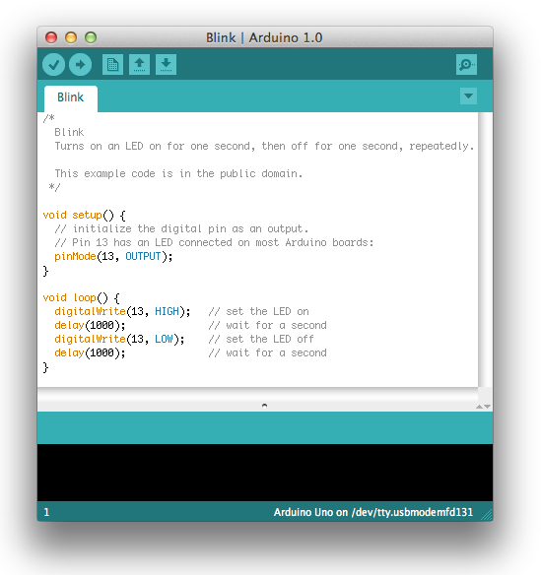
Testing The Arduino IDE
5) Open the Arduino application by double clicking on the icon
6) Open the “blink” sketch by clicking on
File > Examples > 1.Basics > Blink

Slide 8
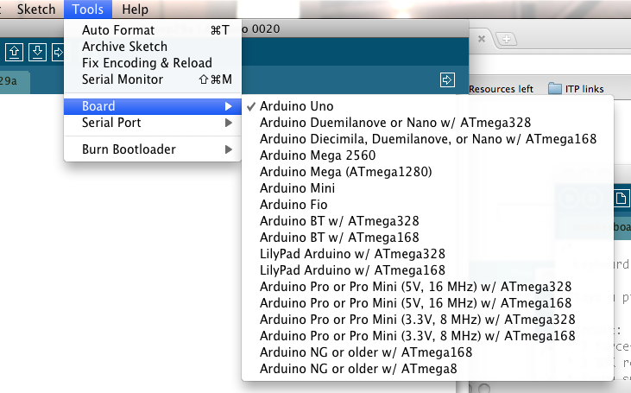
Testing The Arduino IDE
7) Select your board from the Tools > Board menu so the IDE knows which board it is talking to

Slide 9
Testing The Arduino IDE
8) Select the serial device of the Arduino board from the Tools > Serial Port menu. This is likely to be COM3 or higher. To find out, you can disconnect your Arduino board and re-open the menu; the entry that disappears should be the Arduino board. Reconnect the board and select that serial port.
9) Click the upload button. If the upload is successful, the message "Done uploading." will appear in the status bar.

Slide 10
Testing The Arduino IDE
A few seconds after the upload finishes, you should see the pin 13 (L) LED on the board start to blink (in orange). If it does, congratulations! You've gotten Arduino up-and-running, connected your board and uploaded your first sketch!
This is the LED connected to pin 13

